Slide 1

VISVESVARAYA TECHNOLOGICAL UNIVAERSITY “JNANASANGAMA”,BELAGAVI-590018
K R PETE KRISHNA GOVERNMENT ENGINEERING COLLEGE,KR PET-571426
2023-2024
Department of Computer Science & Engineering
Internship Presentation On
“IRIS FLOWER CLASSIFICATION”
Presenting By
B V DISHA 4GK20CS004
SOWMYA B 4GK20CS031
THIPPEGOWDA B M 4GK20CS039
KAVANA S P 4GK21CS406
Under the Guidance of Head of the Department
Dr. Nagappa U Bhajantri Dr. Hareesh K
Senior Professor Associate Professor &HOD
Dept of CS&E Dept of CS&E

Slide 2
Contents
1. Abstract
2. Introduction
3. About the Company
4. Company Certificate
5. Problem Statement
6. Methodology
7. Screenshots
8. Result and Discussions
9. Conclusion
10. References

Slide 3
1. Abstract
IRIS FLOWER CLASSIFICATION
Introduce the project's focus on using neural networks for Iris flower species recognition.
Discuss the use of scikit-learn for simplifying classification tasks and implementing machine learning algorithms.
Emphasize the importance of detecting patterns in iris flower measurements and selecting the most accurate model for precise species prediction.
Highlight the successful application of ANN in pattern classification and their role in modeling class probabilities based on flower features.

Slide 4
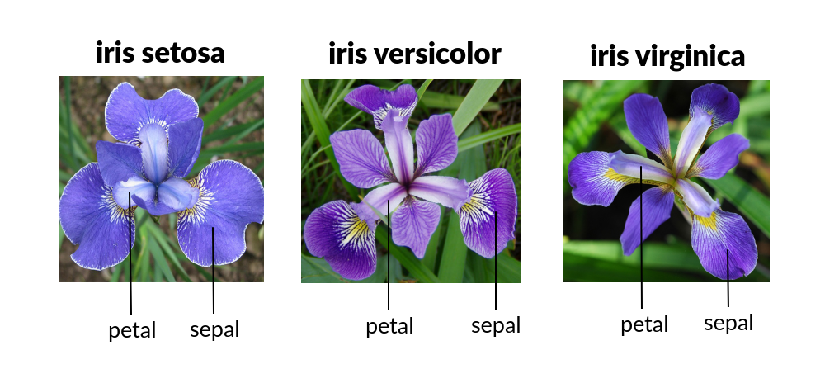
2. Introduction
IRIS FLOWER CLASSIFICATION
To understand various machine learning algorithms let us use the Iris data set, one of the most famous datasets available.
This data set consists of the physical parameters of three species of flower Versicolor, Setosa and Virginica.
The numeric parameters which the dataset contains are Sepal width, Sepal length, Petal width and Petal length.
Fig. 1: Iris flowers

Slide 5

3. About the Company
IRIS FLOWER CLASSIFICATION
Company Name: Inventeron Technologies
Inventeron technologies,we do innovations in Artificial intelligence and embedded systems by building a bridge connecting these two futuristic technologies.
Website: http://www.inventeron.com
Industry: IT Services and IT Consulting
Company Size:51-200 employees,114 associated members
Headquarters: Bangalore, Karnataka
Type: Partnership
Founded:2013
Specialties: Artificial intelligence, embedded systems, machine learning, internet of things, deep learning

Slide 6
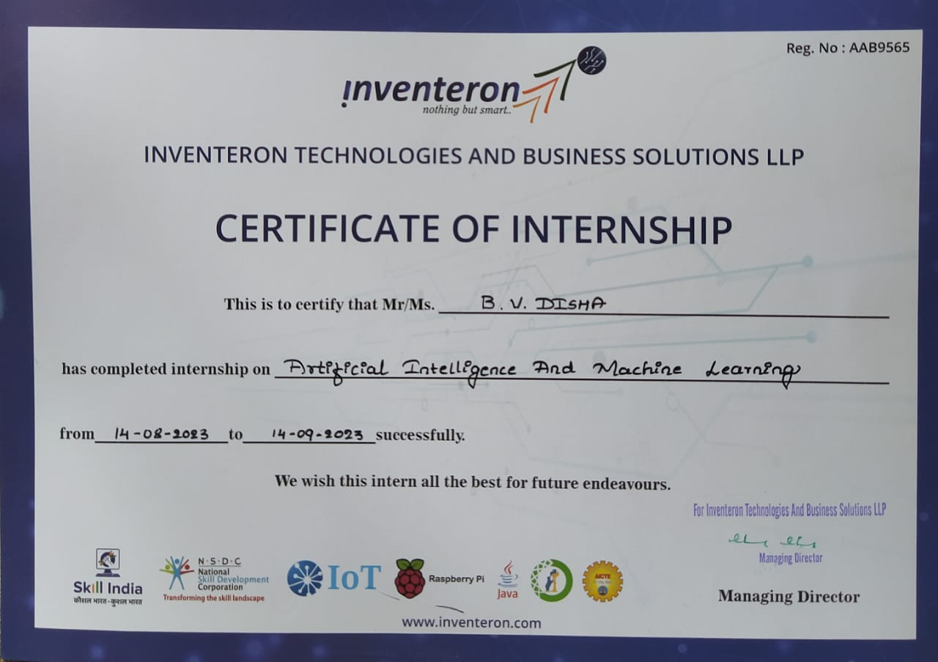
4. Company Certificate
IRIS FLOWER CLASSIFICATION

Slide 7
5. Problem Statement
IRIS FLOWER CLASSIFICATION
Develop a classification model using machine learning, particularly neural networks, to predict Iris flower species based on physical characteristics. The dataset includes measurements of sepal and petal dimensions for Setosa, Versicolor, and Virginica species. The aim is to leverage machine learning algorithms to detect patterns, build a robust classifier, and accurately predict flower species.

Slide 8
6. Methodology
IRIS FLOWER CLASSIFICATION
We used various libraries to build a classification model for the Iris dataset. The following libraries were used are:
Pandas: It is a data manipulation and analysis library used to manipulate data structures such as data frames.
Numpy: used to create multi- dimensional arrays and perform mathematical operations on them.
Matplotlib: Matplotlib is a data visualization library used to create various types of plots and graphs.
Scikit-learn: Scikit-learn is one of the libraries used to build ML models.
Seaborn: Seaborn is a visualization library that provides high-level interfaces for creating informative and important graphs and charts.
Logistic Regression: It is used to find the relationship between dependent and independent variables.
Train_test_split(): The train_test_split() method is used to split our data into train and test sets.
Accuracy_score: sklearn.metrics package calculates the accuracy score for a set of predicted labels against the true labels.

Slide 9
6.1 Block Diagram
Collect the Iris Flower
Statistical computation
data
of Iris data
Dividing the data for
Analysing the data
training and testing
visually
Training of the model
Testing and accuracy
of model
Choose a model and
tune the parameters
Fig. 2: Block diagram of Iris Flower Classifier
Above block diagram is showing the step-by-step process to predict iris flower species.

Slide 10
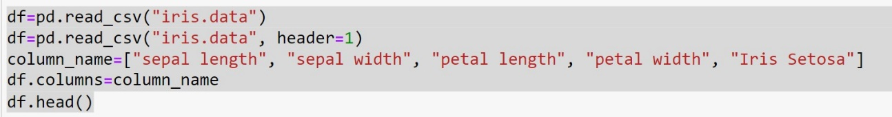
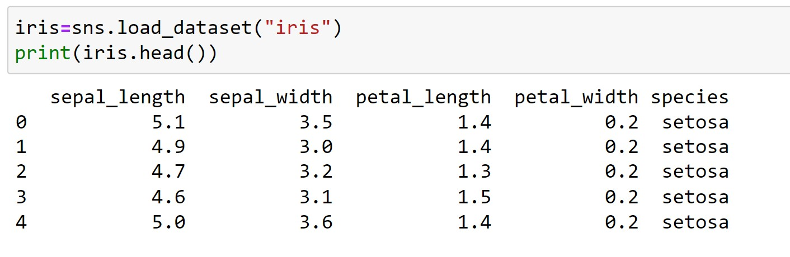
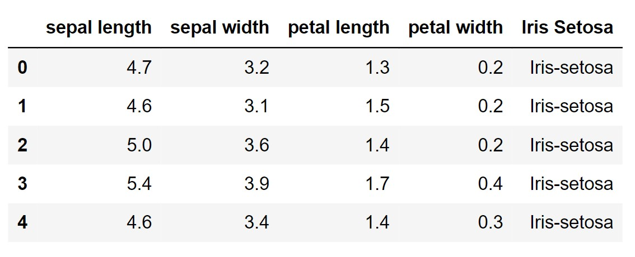
7. Screenshots
IRIS FLOWER CLASSIFICATION
7.1 Data Exploration
Fig 3:Showing Iris Dataset using pandas Library
Fig 4: Showing Iris Dataset using seaborn Library

Slide 11
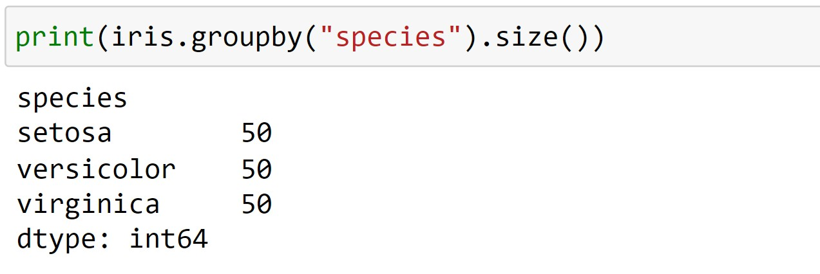
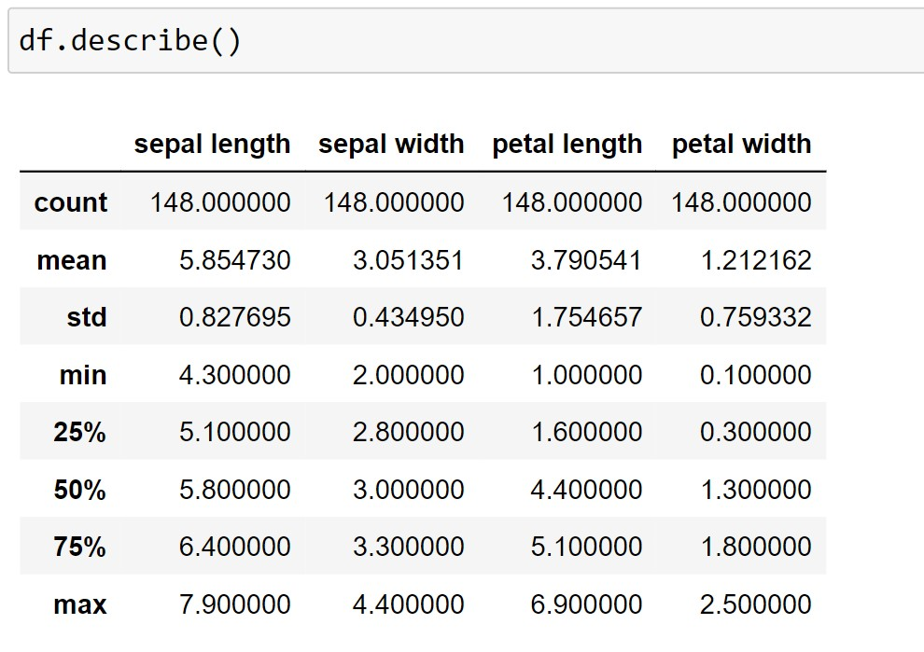
7.2 Data Analysis
IRIS FLOWER CLASSIFICATION
Fig. 5:Species in Iris Dataset
Fig. 6: Statistical description of iris dataset

Slide 12
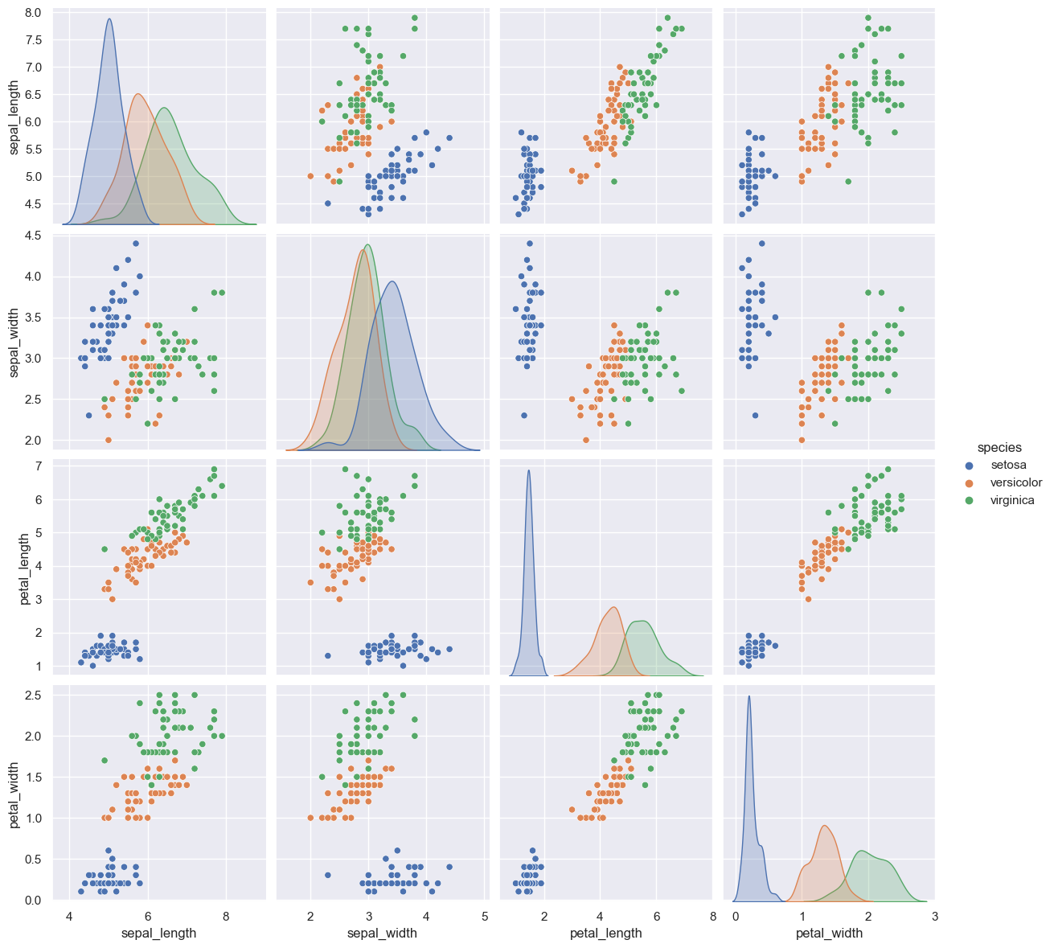
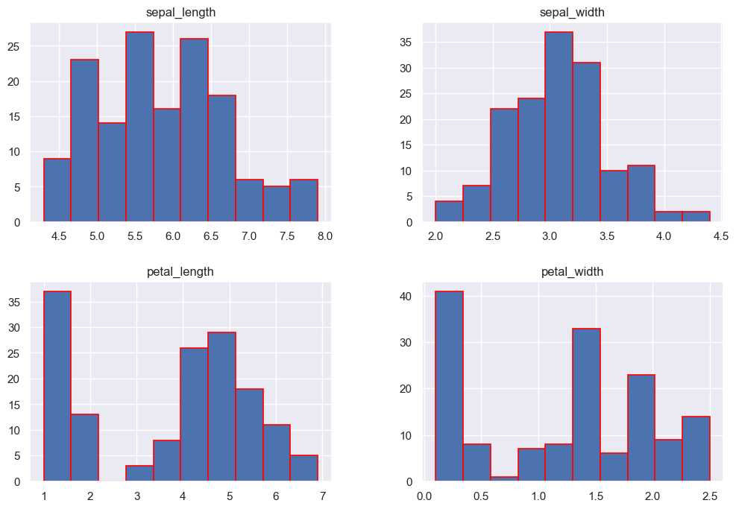
7.3 Data Visualization
IRIS FLOWER CLASSIFICATION
Fig. 7: Pair-plot
Fig. 8: Histogram

Slide 13
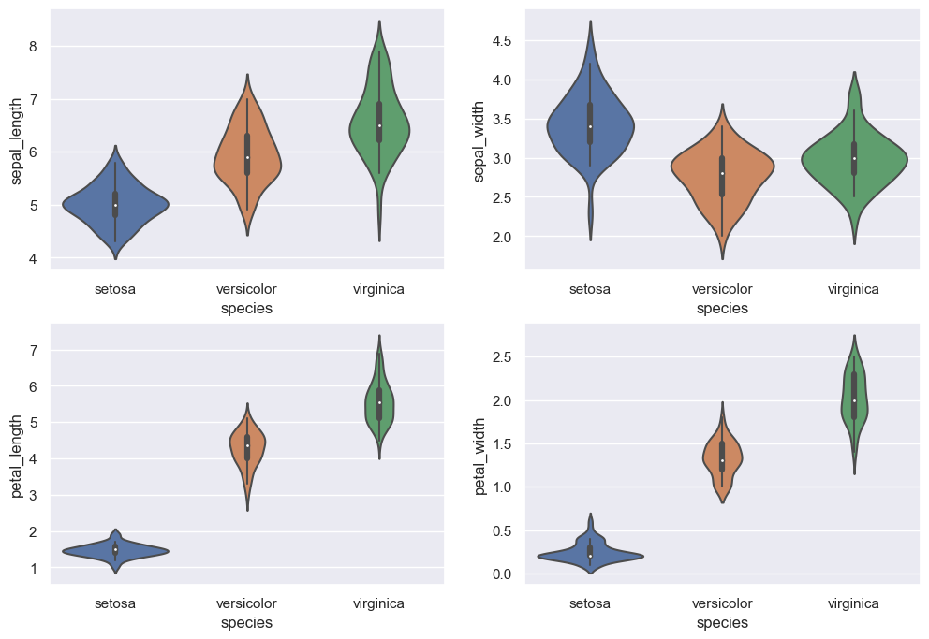
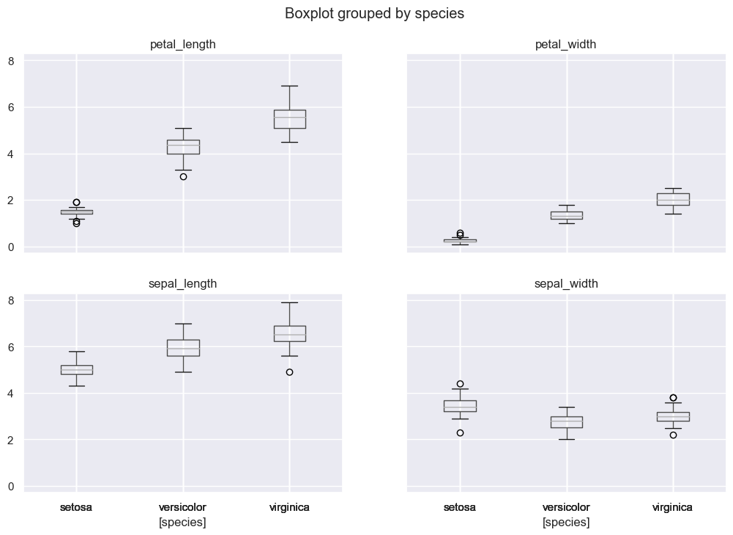
Contd..
IRIS FLOWER CLASSIFICATION
Fig. 9: Violin-plot
Fig. 10:Box-plot

Slide 14
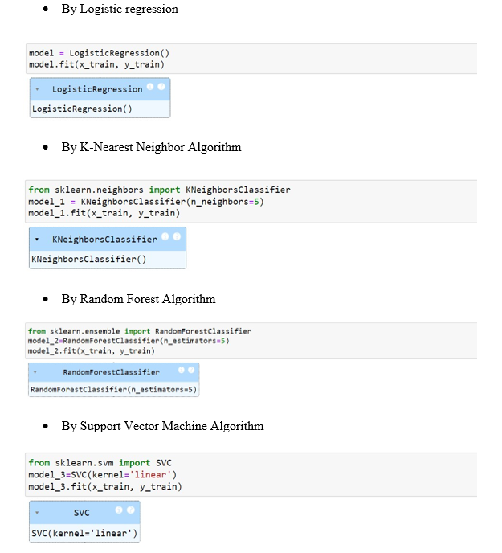
7.4 Training the model
IRIS FLOWER CLASSIFICATION
Fig. 11:Code for train the model

Slide 15
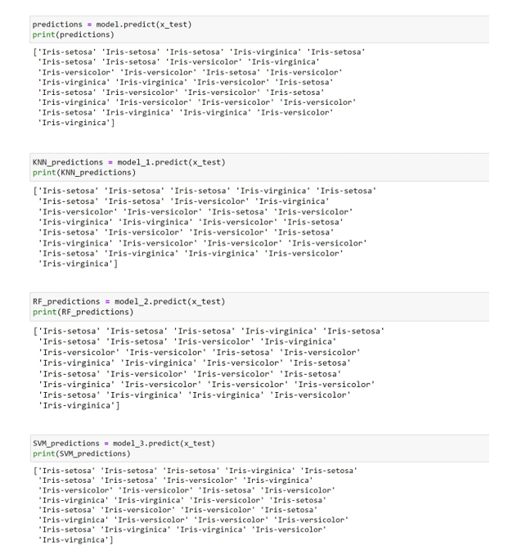
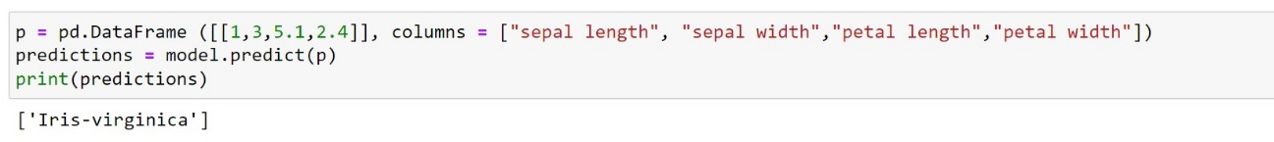
7.4 Prediction of Data
IRIS FLOWER CLASSIFICATION
Fig. 12:predictions of test data
Fig. 13:Prediction of unseen data

Slide 16
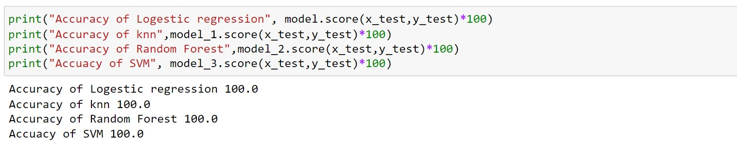
7.5 Accuracy of Models
IRIS FLOWER CLASSIFICATION
Fig. 14: Accuracy of trained models

Slide 17
8.Results and Discussion
IRIS FLOWER CLASSIFICATION
Model Performance Evaluation: The trained neural network model achieved an accuracy of 100% on the testing dataset, demonstrating its effectiveness in accurately predicting the species of Iris flowers based on their physical characteristics.
Generalization and Robustness: The model exhibited strong generalization ability, performing well on unseen data instances. However, further evaluation on diverse datasets and real-world scenarios is necessary to assess its robustness and applicability beyond the Iris dataset.
The results underscore the effectiveness of neural networks in tackling classification tasks, particularly in domains where patterns may be complex or subtle.

Slide 18
9. Conclusion
IRIS FLOWER CLASSIFICATION
In this project, we used the various powerful algorithms to train our data. Processing of data is also important to acquire the best result and as we can see the above results, they are very satisfactory.
The accuracy score of above four models are very good and they can be used to predict the species of iris flower and in four of the above models two models shows the 100% accuracy.
As we can conclude that in future with appropriate data of features of any flower it is possible to classify the species of any flower.

Slide 19
References
IRIS FLOWER CLASSIFICATION
Fisher RA. The use of multiple measurements in taxonomic problems. Ann Eugen. 1936;7(2):179-188.
Dua D, Graff C. UCI machine learning repository. University of California, Irvine, School of Informationand Computer Sciences; c2019.
Chollet F. Deep learning with Python. Manning Publications Co; c2018.
Goodfellow I, Bengio Y, Courville A. Deep learning. MIT press; c2016.
Kaushik P, Yadav R. Reliability design protocol and blockchain locating technique for mobile agent. J Adv Sci Technol (JAST). 2017;14(1):136-141. https://doi.org/10.29070/JAST
Kaushik P, Yadav R. Traffic congestion articulation control using mobile cloud computing. J Adv Scholarly Res Allied Educ (JASRAE). 2018;15(1):1439-1442. https://doi.org/10.29070/JASRAE
Kaushik P, Yadav R. Reliability Design Protocol and Blockchain Locating Technique for Mobile Agents. J Adv Scholarly Res Allied Educ (JASRAE). 2018;15(6):590-595. https://doi.org/10.29070/JASRAE

